Slide 1
History of Anthropological Theory

Slide 2
Anthropological Theory
More than 2,000 societies have been described in anthropological literature
Theoretical orientation: general attitude about how cultural phenomena are to be explained; influences what aspects of life observer focuses on
Anthropological ideas at any given time are reflection of the cultural environment of the anthropologists

Slide 3
Major Theoretical Orientations
Unilineal Evolution
Historical Particularism
Culture & Personality
Functionalism
Cultural Materialism
Neoevolution
Marxist/Political Economy

Slide 4
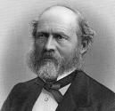
Early Evolutionism
Culture develops in a uniform, progressive manner
Each society passes through same series of stages
Different contemporary societies thought to be at different stages
Evolutionism is largely rejected today - does not satisfactorily explain cultural variation
Edward Tylor and Lewis Henry Morgan

Slide 5
Lewis Henry Morgan (1818 – 1889)
Detailed ethnography of the Iroquois
Ancient Society (1877) – seven stages from lower savagery to civilization – based mainly on technological achievement
Also: Helped make kinship a central concern in modern anthropology

Slide 6
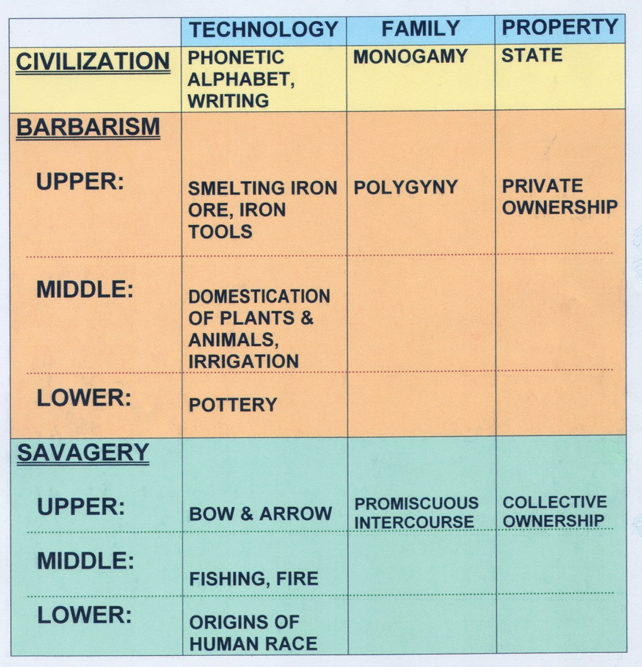
Morgan’s Unilineal Evolution

Slide 7
Edward Tylor (1832 – 1917)
Founding father of anthropology
1896 - First professor of anthropology
First to use “Culture” as a synonym for civilization
All societies pass through three basic stages of development

Slide 8
Tylor’s Unilineal Evolution
Civilization
Barbarism
Savagery
P R O G R E S S

Slide 9
“It would be quite impossible to understand, on the basis of a single evolutionary scheme, what happened to any particular people.” -Franz Boas

Slide 10
Historical Particularlism
All societies or cultures have their own unique history
Rejects evolutionism, ranking of societies on scale of progress (Not Culture, but cultures)
Emphasis on collecting data rather than theorizing
Franz Boas

Slide 11
Franz Boas (1858 – 1942)
Father of American Anthropology
1888 - founded first anthropology department in the U.S.
Studied Eskimo and Kwakiutl, became concerned with disappearance of Native American cultures
The Limitation of the Comparative Method in Anthropology (1896) - anthropologists should spend less time developing theories on insufficient data – should instead collect as much data as possibile
Also: Concept of cultural relativism

Slide 12
Psychological Approaches
Focused on relationship between culture and psychology
Comparative, cross-cultural approach
Studied process of enculturation, especially child development
Ruth Benedict and Margaret Mead (Students of Boas)

Slide 13
Ruth Benedict
1923 - First woman professor of anthropology
Patterns of Culture: Each culture characterized by different personality types
Overgeneralizations

Slide 14
Ruth Benedict
Kwakiutl = individualistic, competitive, intemperate, egoistic
“Dionysian” (Greek god of excess)
Zuñi = control their emotions, value sobriety & inoffensiveness, do not boast, restrained behavior, cooperative
“Apollonian” (Greek god Apollo)

Slide 15
Margaret Mead
Margaret Mead
Studied three societies in New Guinea
1928 – Coming of Age in Samoa
Recognized differences between cultures in gender differences
Gender roles/traits not biological but cultural

Slide 16
Functionalism
Every aspect of a culture plays a particular function in maintaining the cultural system
Bronislaw Malinowski, Arthur Reginald Radcliffe-Brown

Slide 17
Bronislaw Malinowski (1884 – 1942)
Cultural traits serve the inborn needs of individuals in a society
Biopsychological functionalism
Two years of fieldwork in Trobriand Islands set the standard for fieldwork
1922 Argonauts of the Western Pacific

Slide 18
Arthur Reginald Radcliffe-Brown (1881 – 1955)
Various aspects of social behavior maintain a society’s social structure (rather than meet individual needs)
Social structure: total network of existing social relationships in a society
Structural Functionalism
Structure and Function in Primitive Society – 1952 – societies are integrated and social institutions reinforce each other to contribute to maintenance of society

Slide 19
Neo-evolution
Related to early evolutionist views, although less ethnocentric

Slide 20
Theoretical Approaches: Neo-evolution
Leslie White (1900- 1975)
“Basic Law of Cultural Evolution”
Culture evolves as the amount of energy harnessed per capita per year is increased, or as the efficiency of the instrumental means of putting the energy to work is increased

Slide 21
Julian Steward (1902 – 1972)
Multilineal Evolution
Worked with the Shoshoni, noted the influence of the environment on culture
Cultures in similar environments were organized similarly
Cultures in different environments were organized differently
Founder of cultural ecology

Slide 22
Steward V White
White: General Evolution
Steward:
Specific evolution

Slide 23
Cultural Ecology
Examines eelationship between culture and the environment
Steward: explanation for some aspects of cultural variation due to particular environments – & can be tested empirically

Slide 24
ADDITIONAL THEORETICAL APPROACHES….
Political Economy
Structuralism
Ethnoscience
Feminist Approaches
Post-modernist Approaches
Interpretive Approaches
Sociobiology
Hypothesis-Testing Orientation
Read about them in Chapter 14….

